Slide 1
CULVER CITY ENFORCEMENT SERVICES
Enforcement Services Division
Marian Aspnes, Enforcement Services Manager
marian.aspnes@culvercity.org
Office 310.253.5940

Slide 2
Code Enforcement
Enforcement Division Priorities
Enforcement Team
Complaint Lifecycle
Common Municipal Code Complaints & Violations
Sustainability and Leaf Blower Enforcement
Violation Notices, Citations, Fines
Division Statistics

Slide 3
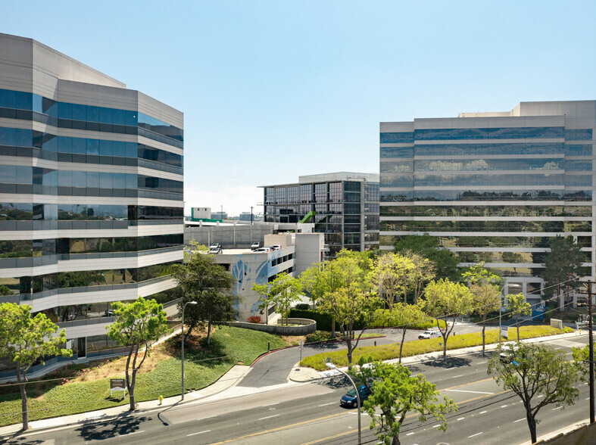
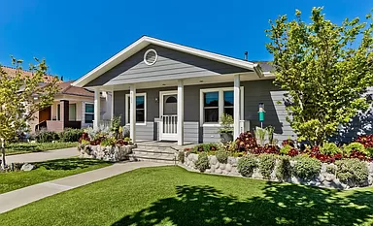
Our Priorities
To foster an environment of voluntary compliance from our business and residential community.
To protect the health, safety, and welfare of our business and residential community by honoring and fulfilling the standards found in the City of Culver City’s Municipal Code.
To ensure property maintenance and proper land use for properties within the Culver City limits.
To serve our neighbors professionally, with integrity, and respect and administer a fair and unbiased enforcement program.

Slide 4
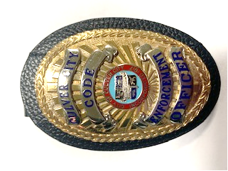
Code Enforcement Team
CODE ENFORCEMENT OFFICER Gerardo Ramirez
CODE ENFORCMENT OFFICER Xochilt Alexander
SECRETARY
Rebecca Bennett
CODE ENFORCEMENT ANALYST
Marna Johnson
A Code Enforcement Officer is an inspector, officer or investigator, who possesses specialized training in, and whose primary duties are the prevention, detection, investigation, and enforcement of violations of laws regulating public nuisance, public health, safety, and welfare, public works, business activities, building standards, land-use, and other municipal affairs.

Slide 5
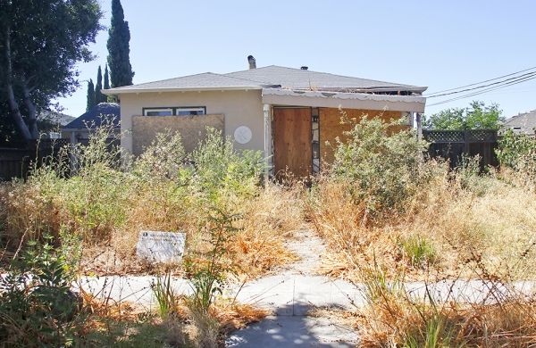
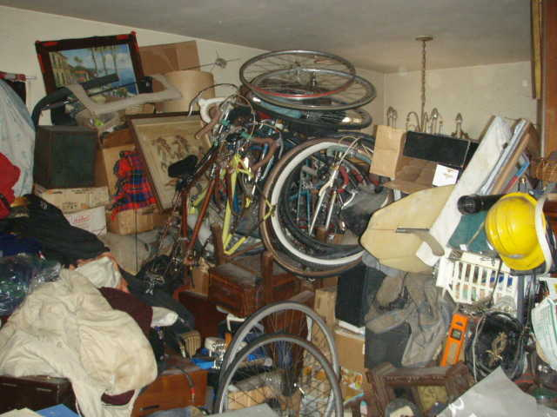
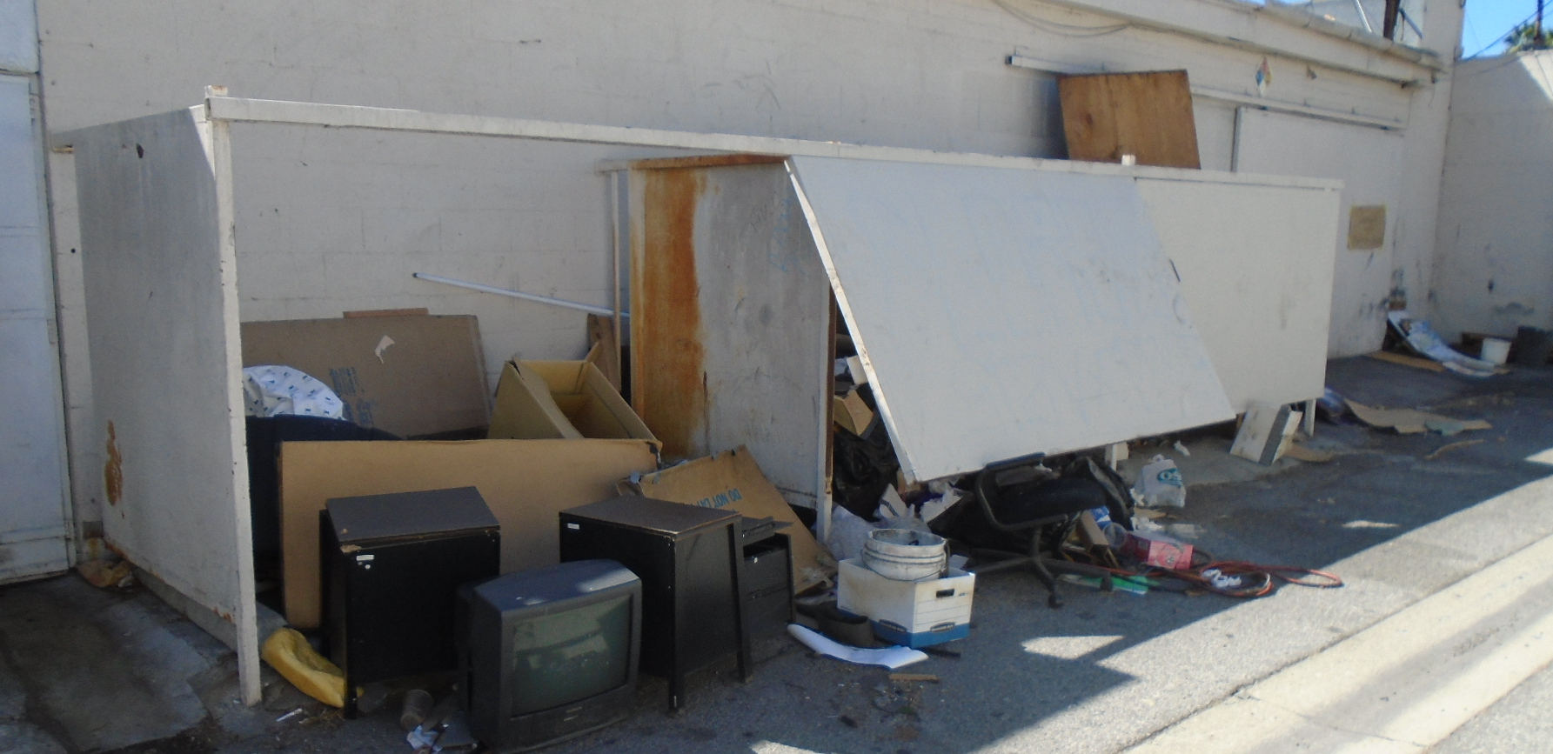
Common Municipal Code Violations
PROPERTY MAINTENANCE
Overgrown grass and vegetation. Dry brush, dead trees.
Hoarding/Accumulation of junk.
Trash and Debris.
Rodents / Insects.
Inoperable vehicles / Junk cars.
Dilapidated/deteriorated exterior and interior structures.

Slide 6
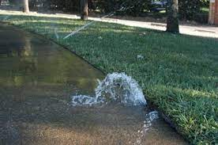
Common Municipal Code Violations Continued
GENERAL - Municipal Code Sections
Noise Nuisance (Construction, Leaf Blowers, Machinery, Business Operations)
Water Waste / Overwatering.
Unhoused Community.
Smoking Ban on Multi-Unit Housing.
Public Nuisance (Sidewalk and Right-of-Way Obstructions, Foul odors/Air Quality, Outdoor storage, Graffiti, Yard Sales, Light Intrusions, etc.).

Slide 7
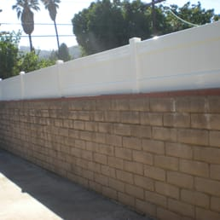
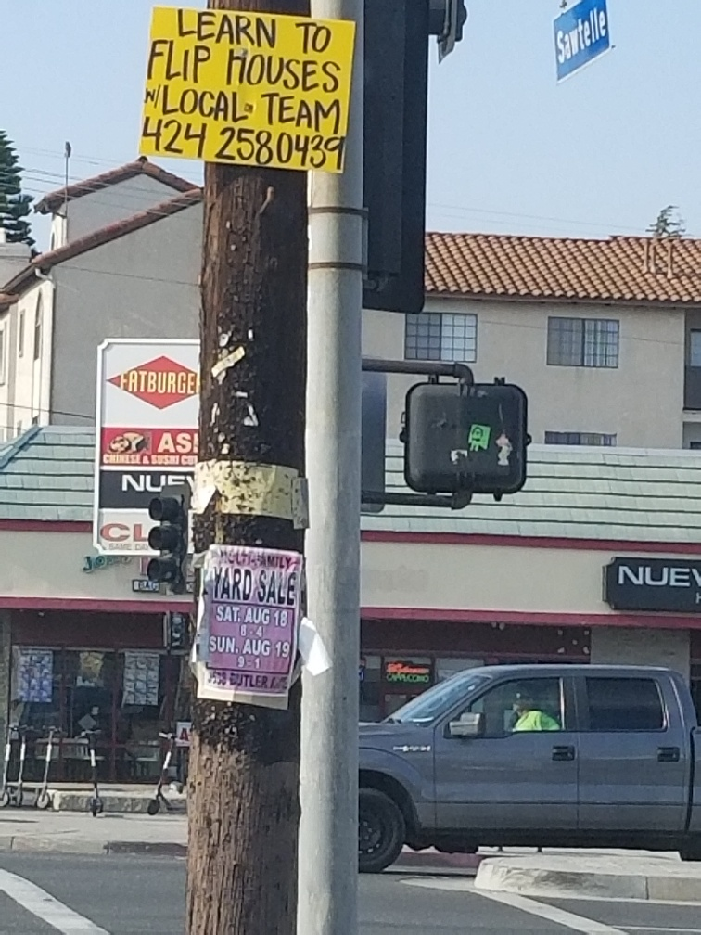
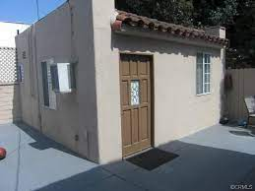
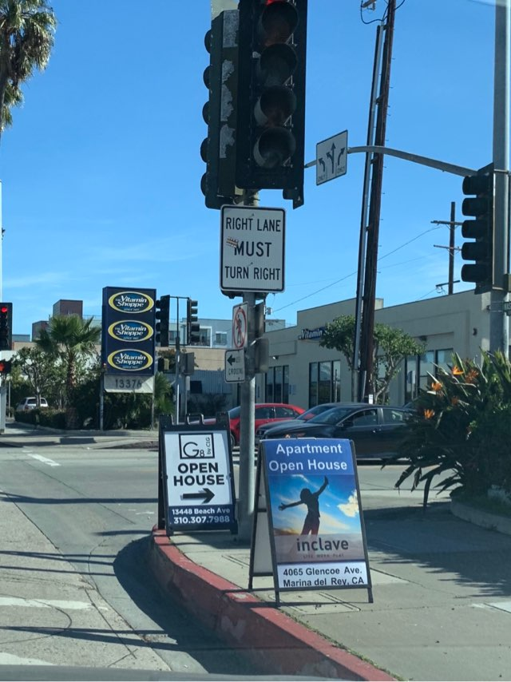
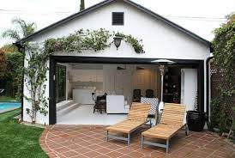
Common Municipal Code Violations cont.
ZONING / LAND USE
Prohibited Signs, Signs in Public Right-of-Way.
Nonconforming structures.
Unpermitted Construction (Garage Conversions/Patio Enc.).
Property Setback violations.
Over Height Fences, Hedges, and Walls.
Parking and Landscape Requirements

Slide 8
Inter-Departmental Assistance
BUILDING SAFETY | HOUSING | PUBLIC WORKS | BUSINESS LICENSE | PARKS AND REC
Unpermitted Construction | Landlord/Tenant Substandard Complaints | Streets and Sidewalk Encroachments | Unlicensed Businesses | Unhoused/Homeless
Electrical Inoperable exposed wiring, etc. | Mobile Home Replacement Program | Solid Waste Services and Homeless Encampment Cleanups | Unpermitted Home-Based Business Activity | Park Patrol
Plumbing Inoperable, Leaking corroded pipes, water heaters, etc. | Health and Safety Repair Issues (Mold, No Heat, Water Damage, etc.) | Illicit Discharge to Storm Drains | Catering Trucks and Street Vendors | Park Permits & Licenses
Mechanical Inoperable items, Air conditions, pool pumps, etc. | Unhoused/Homeless | Outdoor Dining Regulations | Restaurant/ Health Dept. Related Complaints
After-the-Fact Permits | Hoarding | Parkway Landscaping | Illegal Massage
Building Record Reports |  | Polystyrene Ban

Slide 9
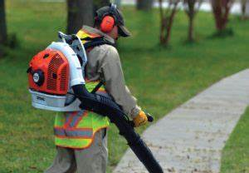
LEAF BLOWER ENFORCEMENT Noise Restrictions Effective November 23, 2022 Municipal Code Sections 9.04.015(I) and 9.07.050(B) LEAF BLOWERS CANNOT EXCEED 65 DECIBELS
Unlawful for anyone to operate or to sell leaf blowers exceeding 65 decibels within the City.
Any person operating a leaf blower must allow an inspection to verify compliance.
Leaf blowers can be used between the hours of 8:00am - 6:00pm Monday - Friday and 10:00am-5:00 pm on Saturday and Sunday.
Leaf blower operator permits are required for commercial use.
No ban on gas powered leaf blowers that meet the lower decibel limits

Slide 10
SUSTAINABILITY ENFORCEMENT COMPLAINTS & EPO REFFERALS CULVER CITY MUNICIPAL CODE – TITLE 5 CHAPTER 5.07
Sept. 1, 2021
Plastics and Packing Material Regulations
Jan. 1, 2022
Polystyrene Packing
Materials and
Take-Out and Delivery
Jan. 1, 2023
Food Service Ware Regulations for On Premises Dining

Slide 11
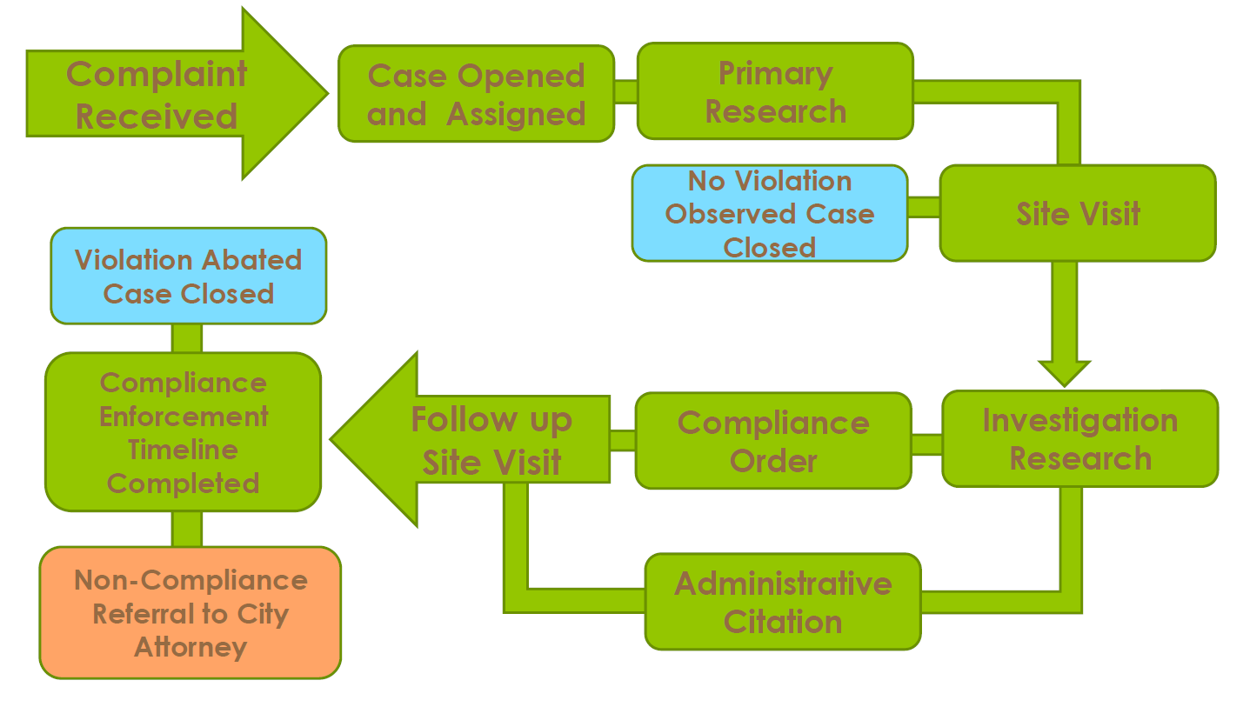
Enforcement Process
1
Receive complaint. Case assigned to Code Enforcement Officer.
2
Code Enforcement Officer researches and investigates the complaint, arranges a site inspection, and documents the conditions observed.
3
Officer will issue either verbal or written warning or Mail a Formal Notice of Violation depending on the severity of violation.
4
5
Officer conducts follow up site visits to monitor and verify that the responsible party has corrected the violations.
If non-compliant, Enforcement Officer may issue Citations for failure to comply. Further non-compliance is referred to City Attorney’s office.

Slide 12
Warnings, Citations, & Fines
1st
Written Warning Notice; or
Stop Work Notice
2nd
1st Violation Notice Issued
Final Warning Notice Issued
3rd
Administrative Citation Issued
First $100 – Second $200 – Third $500
4th
Referred to City Attorney’s Office
5th
Referral to third party City Prosecutor
Appeal Hearings and Receiverships
Civil/Criminal Prosecution – Abatements, Misdemeanors, Felony Charges

Slide 13
Enforcement Requests
YEAR | REQUESTS/ COMPLAINTS
2018 | 1,011
2019 | 1,373
2020 | 779
2021 | 731
2022 | 617

Slide 14
Enforcement Complaints

Slide 15
Other Enforcement Duties
Leaf Blower Permits
Cannabis Regulations Permit Plan Review and inspections
Massage Businesses Inspections
Amnesty Program
144 properties under Amnesty
Unhoused
Support Outreach Efforts and Site Cleaning
Park Patrol
2 Officers patrol and monitor all Culver City parks.

Slide 16
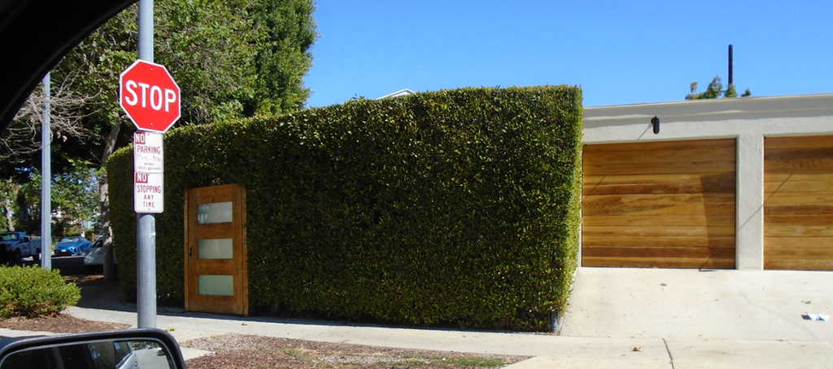
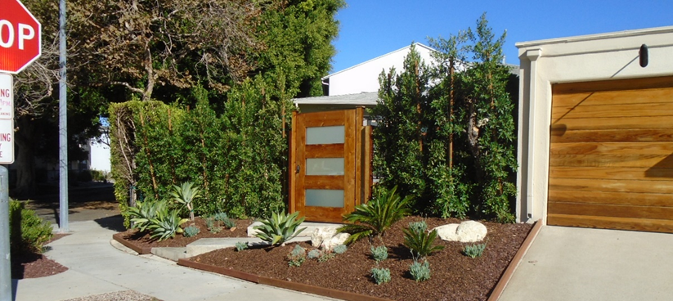
Before and After
HOARDING / ACCUMULATION
OVERGROWN HEDGES/VEGETATION

Slide 17
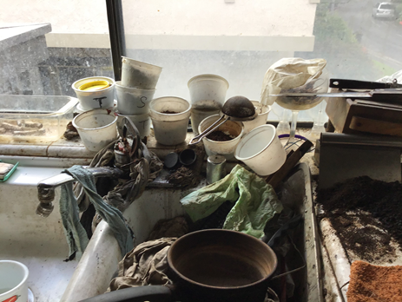
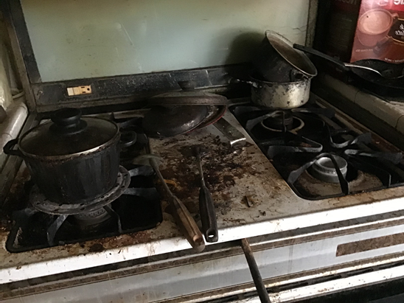
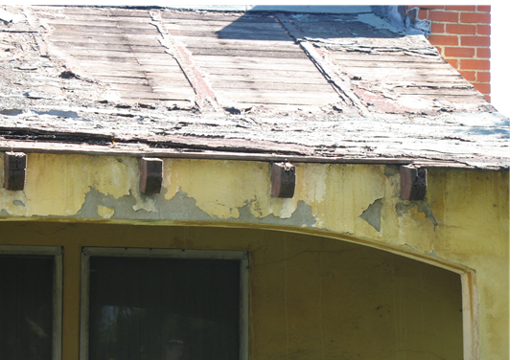
BEFORE AND AFTER
DILAPIDATED ROOF
UNSANITARY HOUSING

Slide 18
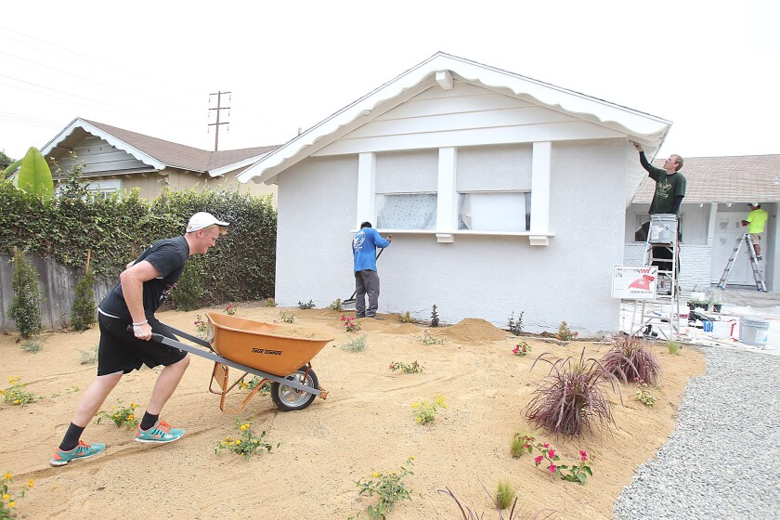
Good exercise for the heart: reach out and help your neighbor.
Mark Twain

Slide 19
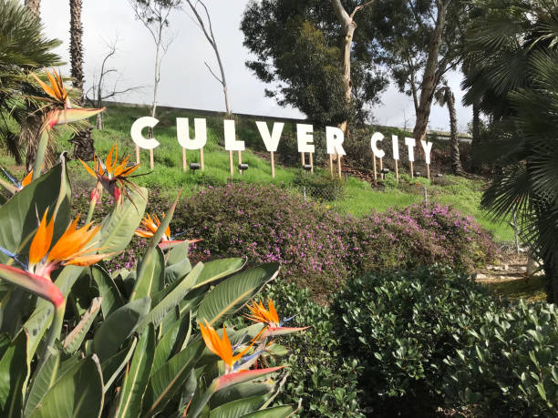
THANK YOU
WAYS TO REPORT A CODE VIOLATION
Enforcement Division (310) 253-5940
Culver City Hotline (310) 253-5555
Email code.enforcement@culvercity.org
Graffiti Hotline (310) 253-6420
Access Culver City’s Website: https://www.culvercity.org/CityHall/Departments/ Community-Development/Code-Enforcement/
Mail Complaint or Public Counter Assistance: Culver City Enforcement Services, 2nd Floor 9770 Culver Boulevard Culver City, CA. 90232

