Slide 1
Complying with SB1383, California’s Short Lived Climate Pollutant Reduction Strategy
Presented by: Daniel Pankau, City of Culver City
Notes:
Good Evening Everyone. My name is Daniel Pankau w/ City of Culver City Environmental Programs & Operations. I am going to give an update on the citys compliance efforts w/ Senate Bill 1383 California's Short Lived Climate Pollutant Reduction Strategy

Slide 2
SB 1383: Overview
In September 2016, Governor Brown signed into law Senate Bill (SB) 1383 (Lara, Chapter 395, Statutes of 2016, Short-Lived Climate Pollutants: Methane Emissions Reductions)
SB 1383 establishes methane emissions reduction targets to reduce emissions of short-lived climate pollutants.
50% Reduction in State-wide disposal of organic waste by 2020.​
75% Reduction in State-wide disposal of organic waste by 2025. ​
20% Recovery of edible food currently disposed for human consumption by 2025.
Notes:
I know the council members and sustainability folks are familiar w/ SB1383. But just to recap the bills central focus it to reduce landfill methane emissions by diverting organics including edible food from the trash. The bill was signed into law in 2016 and established the following reductions targets, 50% Reduction of organic waste by 2020, 75% reduction of organics waste by 2025 & 20% reduction of edible food currently disposed for human consumption by 2025

Slide 3
Since January 1, 2022 Jurisdictions must have the following programs in place
Adopt an enforceable ordinance or other mechanism for organic waste collection service waste or self-hauling (sections 18981.2(a) & 18988.1(b))
Construction and Demo Recycling in accordance with the California Green Building Standards Code, Title 24, Part 11 and 14 CCR Sections 18989.1/18989.2
Model Water Efficient Landscaping (MWELO) see 14 CCR Sections 18989.1/18989.2
Develop inspection, compliance review, and enforcement programs (sections 14 CCR 18995.1-18995.4)
Meet procurement requirements. See 14 CCR Sections 18993.1 - 18993.4
Edible Food Recovery Program for Tier 1 (Tier 2, Jan 1, 2024) See 14 CCR Sections 18991.1 - 18991.5 and Education and Outreach 14 CCR Section 18985.1/18985.2
Notes:
1)Council adopted our revised organic recycling SB1383 ordinance in 202 1to satisfy this requirement.
2)All C&D material is picked up by culver city sanitation…our C&D material is processing facility is currently certified by LASAN at 88.63% diversion well above the requirement
3) 5.08.045 MODEL WATER EFFICIENT LANDSCAPING ORDINANCE in place for new and redevelopment projects
4) Procurement activities include city sponsored compost giveaways and mulch application to rain gardens. Additional applications of compost as a turf topcoat are being coordinated for the back-half of the calendar year. Additional applications of mulch at rain garden locations are planned for the remainder of the SB1383 reporting cycle
5) Have completed first round of organics contamination inspections w/ our oops and awesome tags. Have summited our initial SB1383 report, capacity planning documentation to LA County & our EAR is due on 10/3
6) We have identified 17 Tier 1 commercial generators We have identified 41 Tier 2 commercial generators All have been mailed educational material regarding SB 1383 requirements.

Slide 4
Notes:
SB1383 is the largest and most comprehensive piece of solid waste legislation in the states history. While the EPO division takes the lead on the compliance and operations of the organic recycling programs, it is truly a team effort spanning various departments in cooperation w/ LA County and the organic processing facilities

Slide 5
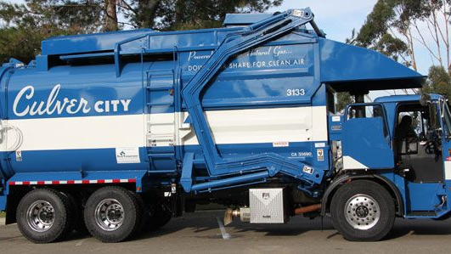
SB 1383: Collection & Processing
Provide organic waste collection services (including paper and cardboard collection) to all organic waste generators.
Culver City three-container collection system
Conduct route reviews
Notify generators of recycling requirements if contamination is found
Provide collection containers to generators to comply with color requirements
Label all new containers or lids with SB 1383-compliant lids
Notes:
We are continuing to enroll additional organics collection locations each month. We were initially focused on the locations that we assumed generated organics such as Rest, Cafes, Mini Marts, Hotels…. So far this year we have enrolled approximately 200 additional organic collection locations. We anticipate enrolling another 300 locations by the end of the calendar year. All new participants received educational materials on what can be placed into their new compliant containers w/ complaint lids and labeling. Concentrated route reviews for contamination will be rolled out the first part of 2023. With our revised SB 619 designation we are ahead of our compliance timeline targets (more on that later)

Slide 6
By January 1, 2022
Notes:
The entire city of culver city falls under the 3 container source separated collection service. One bin for recycle, one for refuse and one for organics.

Slide 7
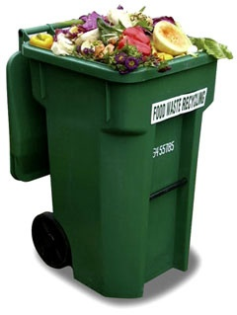
Single Family Residential
95%+ participation rate with organics collection at single family residential locations. Our program allows for both commingled food waste and green waste to placed into the carts for curbside collection
Notes:
Culver City has been ahead of the curve when it comes to allowing food scraps into the organic collection containers. We have had this program in place for years with a very high participation/compliance rate for single family residential locations. All organics material collected is taken to Crown Recycling Services where it is ground and then transported to our contracted compost facility Blossom Valley Organics South in Kern County. Neat fact, this open windrow compost facility is the largest west of the Mississippi based on footprint. This is same finished compost that is distributed at our compost giveaway events

Slide 8
Commercial Locations
EPO Staff along with our consultant Go2Zero continue to inspect, educate and enroll new commercial locations into our organics program. Including multi-family properties, we have enrolled approximately 200 new organic accounts over the last year.
Notes:
We targeted “hot 100” subsets of focusing on locations that we assumed would generate organics this included Restaurants, Cafes, Minimarts. We will continue to inspect, educate and enroll additional locations into the organics program throughout the remainder of this calendar year. We are estimating an additional 100 locations per month in October November & December. This would either be a commercial dumpster as pictured or a residential cart for some of the lower volume locations. Our agreement with Cal Recycle allows us until Dec 31st 2023 for full program implementation.

Slide 9
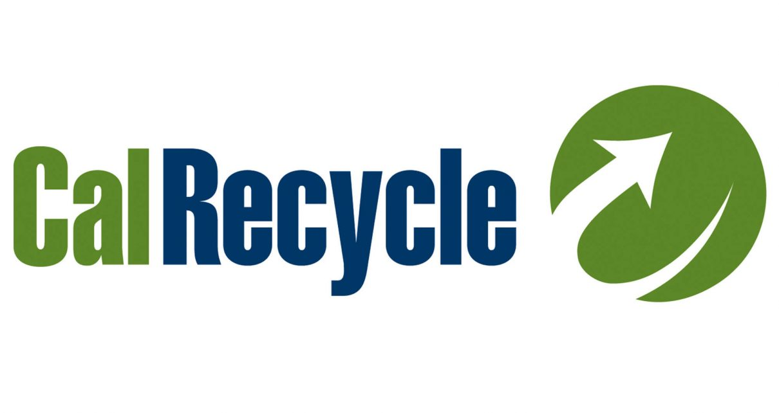
619 Notice of Intent to Comply “NOIC”
Applied and approved for 619 designation for our 3- container collection program. We now have until the end of 2023 for full implementation.
Notes:
In response to the challenges associated with the Covid 19 pandemic, Gove Newsom signed Sen Bill 619 into law to support local governments as they implement successful organic waste recycling throughout the state. The law authorizes CalRecycle to waive civil penalties for some or all of the regulatory requirements of SB 1383. After much internal discussion and with state cal recycle representatives we decided to apply for a NOIC specific to the compliance with the 3 container organics program at all applicable locations. Our application was approved by the state in March of this year and as designed gives us to Dec 31st 2023 to roll out our organics program to all applicable locations

Slide 10
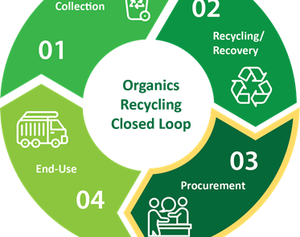
By January 1, 2022 Jurisdictions must have the following programs in place.
Meet procurement requirements (18993.1 -18993.4):
organic waste like compost, mulch
purchase recycled paper products of 30% post consumer content
Product procurement requirement= .08 tons of organic waste x population = 3,184 Tons of Organic Waste Annually
Notes:
We have our environmental purchasing policy in place as of October 18th 2021. This policy complies with SB1383 regulations by supporting organic waste disposal reduction targets & markets for products made from recycled and recovered materials and to purchase recycled content paper products and recycled content paper products.
Procurement activities include city sponsored compost giveaways and mulch application to rain gardens. Additional applications of compost as a turf topcoat are being coordinated for the back-half of the calendar year. Additional applications of mulch at rain garden locations are planned for the remainder of the SB1383 reporting cycle

Slide 11
Procurement Extension- AB 1985
Notes:
Governor Newsome just signed Assembly Bill AB1985 that establishes an additional two-year phase in period for cities to meet their procurement requirement targets. We will continue to increase our distribution and application of high quality finished compost and mulch throughout the city to meet these targets.

Slide 12
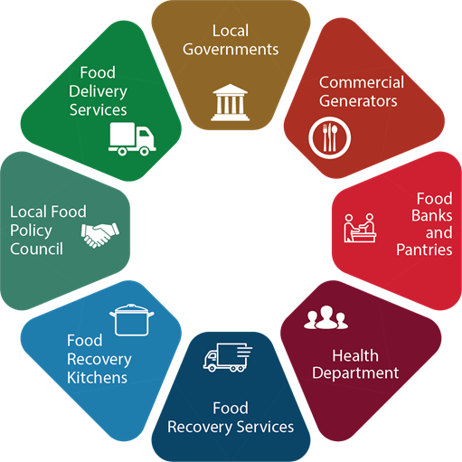
Edible Food Recovery Program 14 CCR Sections 18991.1 - 18991.5
Identify Existing Food Recovery Capacity (LA County)
Ensure commercial edible food generators have access to food recovery services
Monitor commercial edible food generators for compliance
Education & Outreach to both Tier 1 & 2 Generators
Notes:
In cooperation with the County of Los Angeles we have submitted our initial food recovery capacity data. This identified potential donor locations along with applicable Tier 1 & 2 generators within the city
We have mailed out educational materials to both Tier 1 & 2 Generation facilities (the generators and donor locations have their own specific requirements under sb1383)
We also have a separate but related grant funded edible food recovery grant from the state. We have purchased a refrigerated truck, have drivers w/ food handlers certificates and a partnered donor location. We are working with several potential generators (restaurants) that might participate. We hope to have that program up and running by the end of the calendar year

Slide 13
Edible Food Recovery Program
Annual education is required for all businesses and residents about relevant requirements.
Commercial edible food generators shall receive outreach and education about food donation requirements and available food recovery organizations.
Material must be accessible to non-English speaking residents (February 1, 2022).
Notes:
This slide just highlights the jurisdictional requirements for Edible Food Recovery under SB1383. We have met all of these initial requirements and submitted that information in both our initial report and upcoming Electronic annual report.

Slide 14
Summary of SB 1383 Programming Costs
Required Tasks | One-Time Costs | Annual Costs
Collection & Processing | $0.00 | $200,000
Monitoring | $100,000 | $75,000
Enforcement | $88,000 | $50,000
Product Procurement | $200,000 | $150,000
Reporting & Record Keeping | $11,000 | $25,000
Edible Food Recovery | $500,000 (received a grant from CalRecycle) | $50,000
Outreach & Education | $50,000 | $50,000
TOTAL | $949,000 | $600,000
Notes:
These are the estimated programming costs associated with SB1383 compliance. We will have a more complete cost picture once we compile our first full year reporting cycle that is due August 2023

Slide 15
Important Dates
1 Jan. 2022
Regulations take effect & state enforcement begins
31 Dec. 2023
619 compliance extension for 3 container collection
1 Jan. 2024
AB 1985 compliance extension for procurement requirements
1 Jan. 2036
Color coded container requirement
Notes:
Here is a simple timeline showing upcoming important dates
This regulations went into effect this January
With the 619 compliance extension we need full implementation of our 3 containers collection program at all applicable locations by the end of 2023
With AB 1985 compliance extensions we need to meet our procurement requirements by Jan 1 2024
We technically have until Jan 2036 to meet the correct color requirements for all bins. We anticipate compliance much sooner than that….all new accounts and replacement containers meet both the color and label requirements.

Slide 16
Thank you. Any questions.
Daniel Pankau, Daniel.Pankau@culvercity.org
Notes:
Thank You

